Slide 1
1
Typed languages
7
Polymorphism
OOP
2
Object/Class
6
Inheritance
3
Aggregation
5
Objects references
4
Encapsulation

Slide 2



ACTIVITY 1
15 MIN
1 - write the UML class diagram to answer this problem
2 – write the corresponding code
• All drinks have a name and a price
• Coffee is a drink, but additionally has a quantity of sugar
• Orange juice is a drink, but additionally has a number of oranges

Slide 3
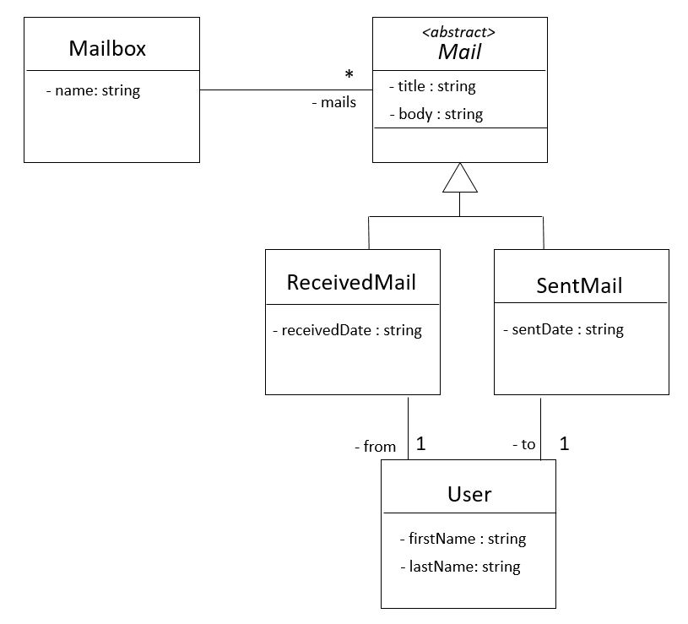
ACTIVITY 2
15 MIN
A mailbox contains sent and received mails.
TODO : Given this UML class diagram, write the corresponding code

Slide 4
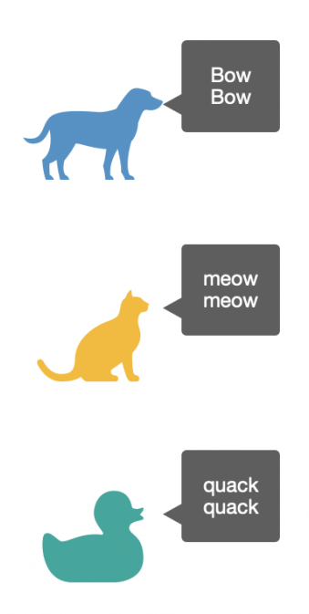
What is the
Polymorphism?
Dog
+ playSound()
<<abstract>>
Animal
Cat
+ playSound()
+ playSound()
Duck
+ playSound()

Slide 5
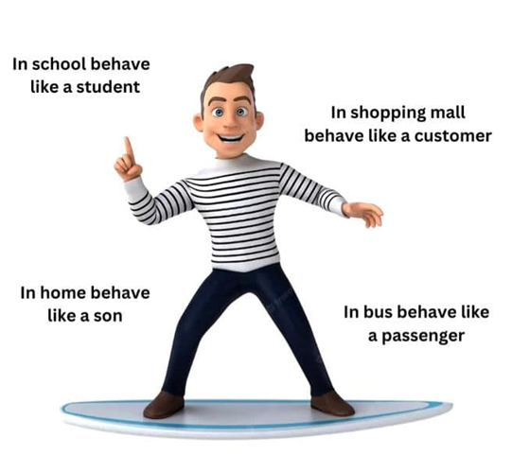
What is polymorphism?
POLY = MANY
MORPHISM = SHAPE

Slide 6
What is polymorphism?
Polymorphism is the ability of an object to take on many forms.
It happens when children classes overwrite a parent method
Animal
Cat
Cat will overwrite
the behavior
of the parent method
+ soSomething()
+ soSomething()

Slide 7
Salary in IT companies
Position | Salary in dollars
IT Developer | Number of skills * 500$ if developer knows OOP => +2000$
Manager | Number of team members * 600$
Commercial | Number of contracts * 400$

Slide 8
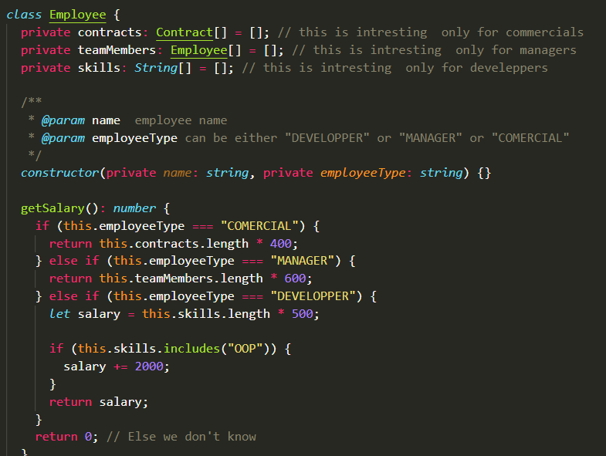
This is the messy code
We’ve got….

Slide 9
ACTIVITY 3
20 MIN
• Change the given to and create the appropriate classes
• Use polymorphism to provide the right salary for each kind of employees

Slide 10

What’s happen if we make a mistake on MANAGER ?
if (employee.category == “MANAGERE”) {
salary = 500;
}
Using STRING to manage categories, types of element
is not really safe !!!

Slide 11
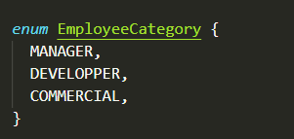
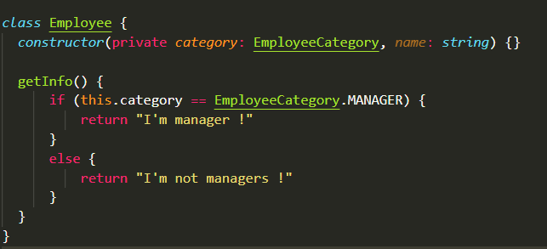
What is an enum ?
A enum is a set of predefined named value
ENUM VALUE
IN UPPERCASE
DEFINITION
USAGE

Slide 12

UML representation of Enum
<<Enum>>
WeekDay
MONDAY
TUESDAY
Don’t need to details the values

Slide 13
ACTIVITY 6
20 MIN
Create an enum Gender: MALE or FEMALE
Create an enum Major: WEP or SNA
Create an enum Topic: JAVASCRIPT, PHP, HTML, TS, VUE
Create a class Student
Create a class Result
<<enum>>
1
Student
Result
Gender
<<enum>>
*
- score: number
Topic
- name:string
<<enum>>
1
Major

Slide 14

NOW I KNOW :
When to use abstract classes
Benefits of polymorphism: let the subclass decide about something
What is an Enum and its benefits

